Slide 1
Introduction to Windows and CMD
Cybersecurity
Lesson 7.1

Slide 2

Learning Objectives
By the end of today’s class, you will be able to:
1
Leverage the Windows Command Prompt (CMD) to navigate and manage directories and files.
2
Explain how Windows stores files.
3
Create, manage, and view user information using the command-line tool net.
4
Manage password policies using gpedit.
5
Optionally, schedule tasks using Task Scheduler.

Slide 4
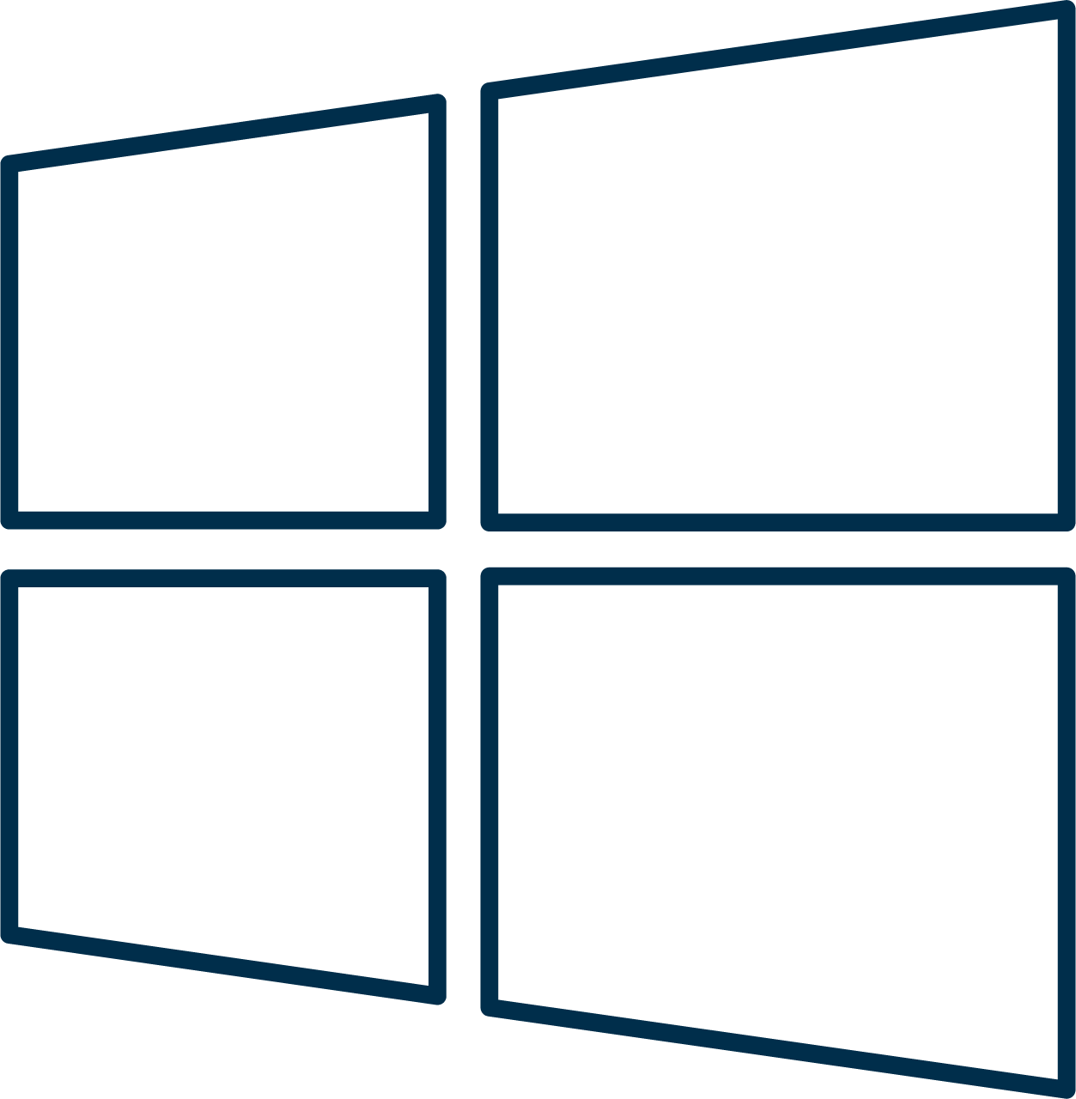
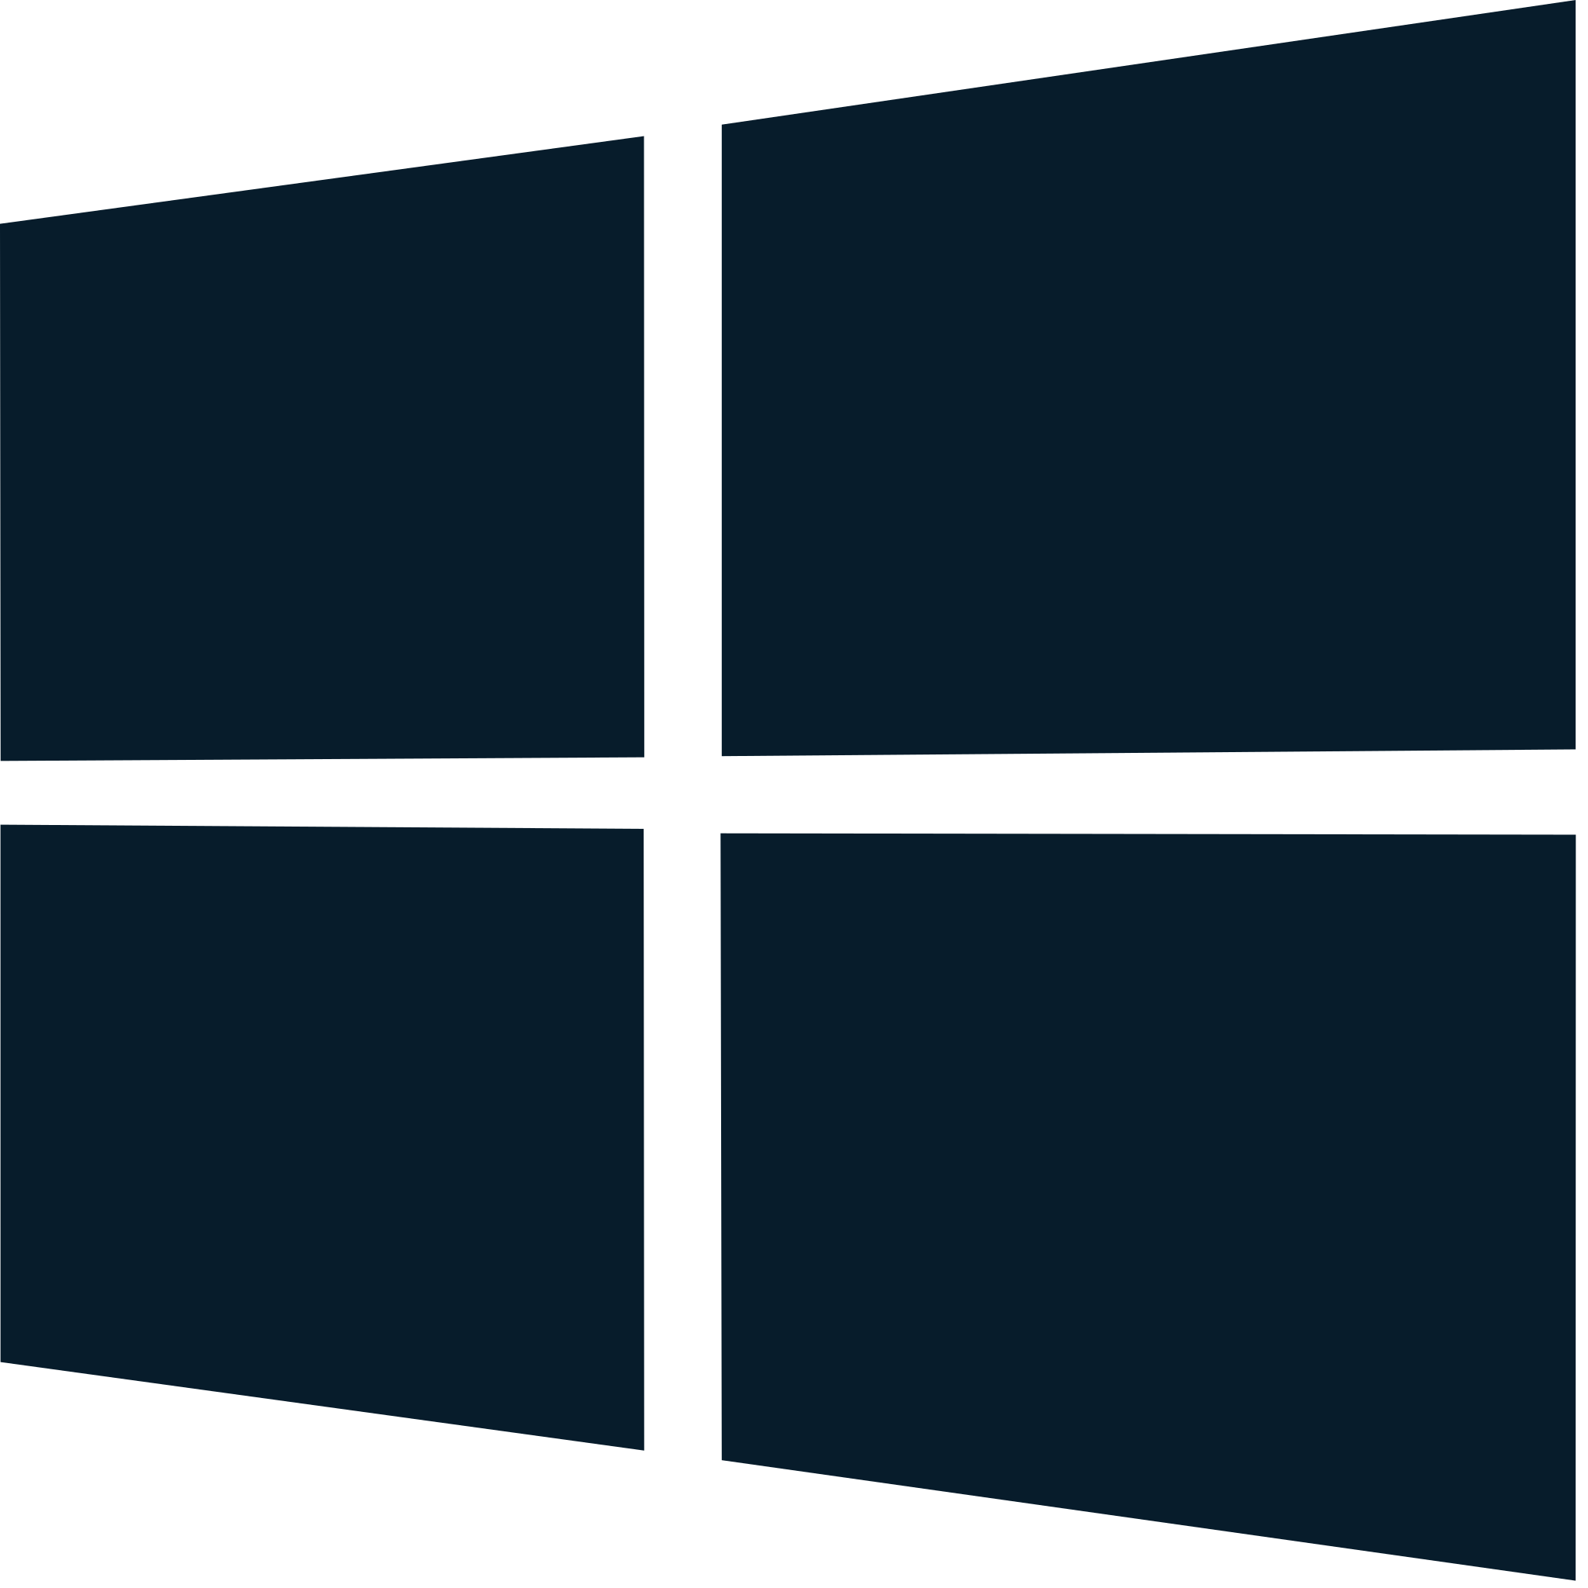
Introduction to Windows

Slide 5


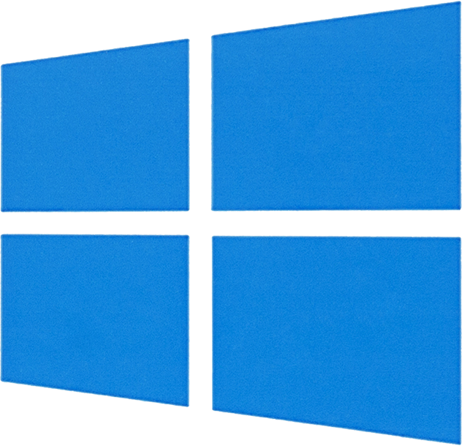
Welcome to Windows
Windows is the leader for desktop operating systems.

Slide 6


The popularity of Windows machines make them the most common target.

Slide 7



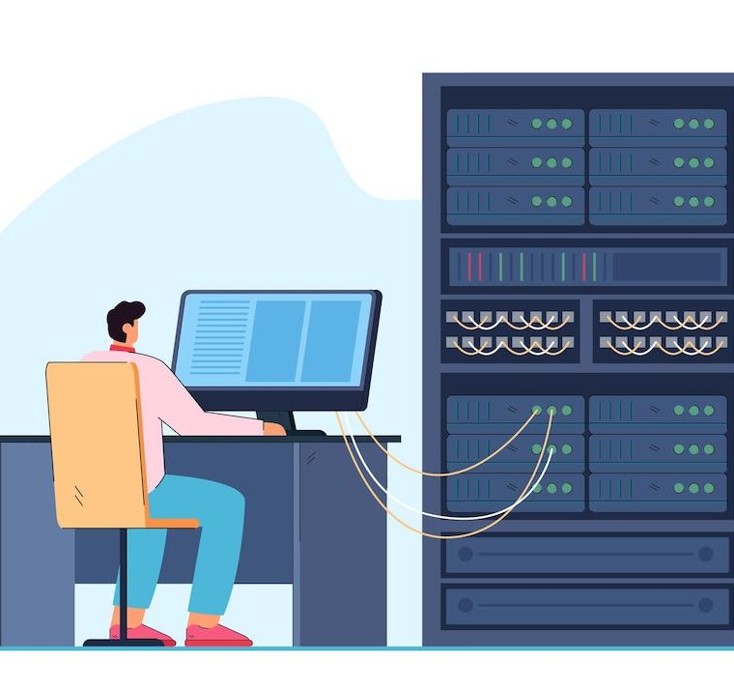
Windows knowledge is essential in many roles:
SOC Analyst
System Administrator
SOC analysts must monitor and detect suspicious activity on Windows devices.
Most system administrators work with one or more Microsoft products and/or services.

Slide 8
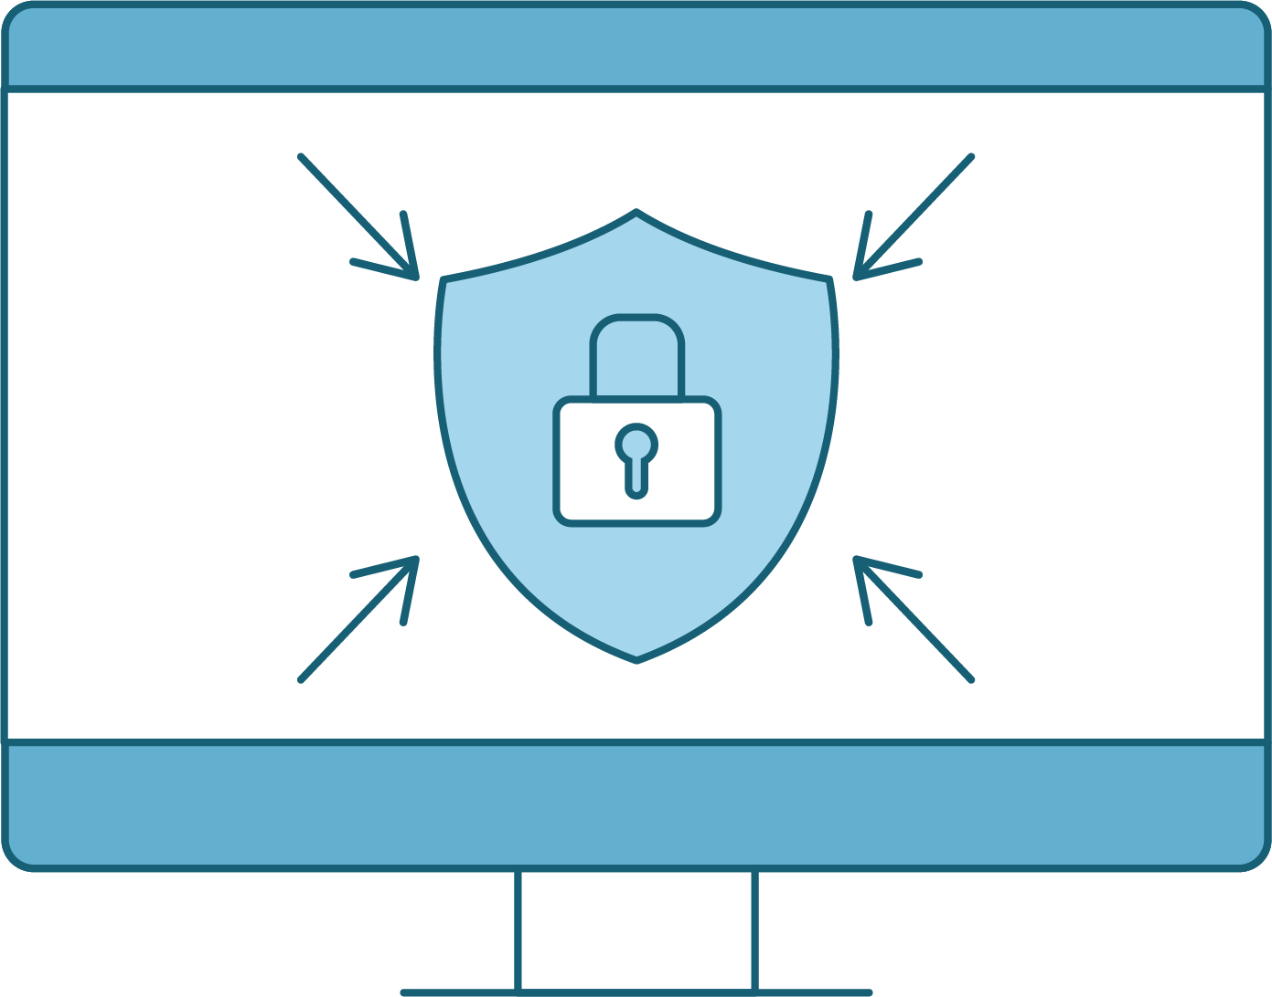

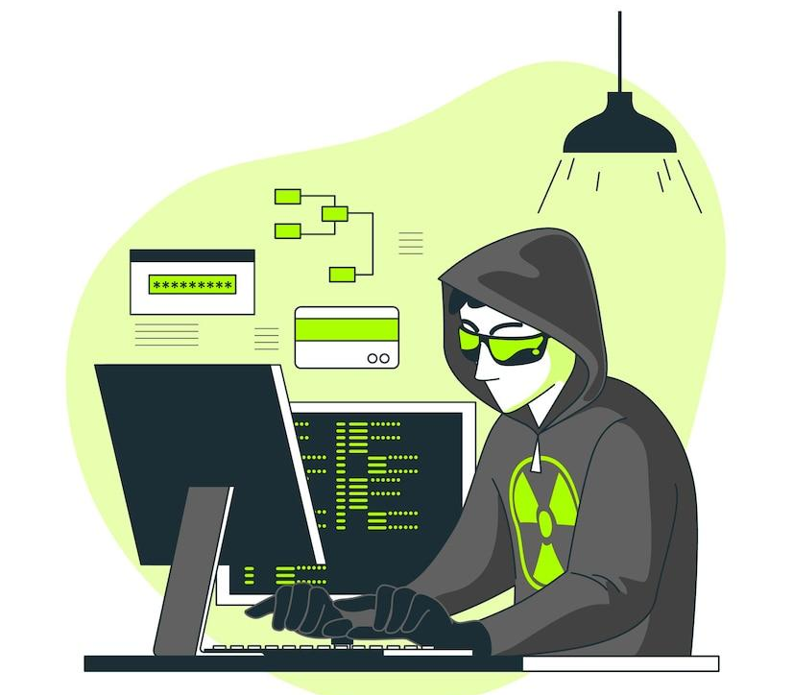

Windows knowledge is essential in many roles:
Penetration Tester
Endpoint Forensics
Penetration testers need to know how to exploit Windows and Microsoft-related products.
Forensics investigators have to have a detailed understanding of how Windows works.

Slide 9
Windows System Administrator
Today's activities will cover common system administration tasks:
Audit processes with Task Manager.
Use the command line to gather information and create files.
Enforce password policies.
Manage users.
Automate tasks.

Slide 10
Launching Your Windows Lab

Slide 11
Before we get started, let’s log into, and launch our Lab environment.

Slide 12
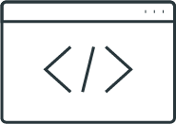
Introduction to Task Manager

Slide 13

Did you notice the excessive number of processes that started up when you logged into the Windows VM?
This is what a Windows workstation
can be like if not maintained by an organization’s system administrator.
Notes:
shutterstock_1229109085

Slide 14
During our Linux modules, we used top to enumerate running processes.
In Windows, we utilize different tools to inspect processes.

Slide 15
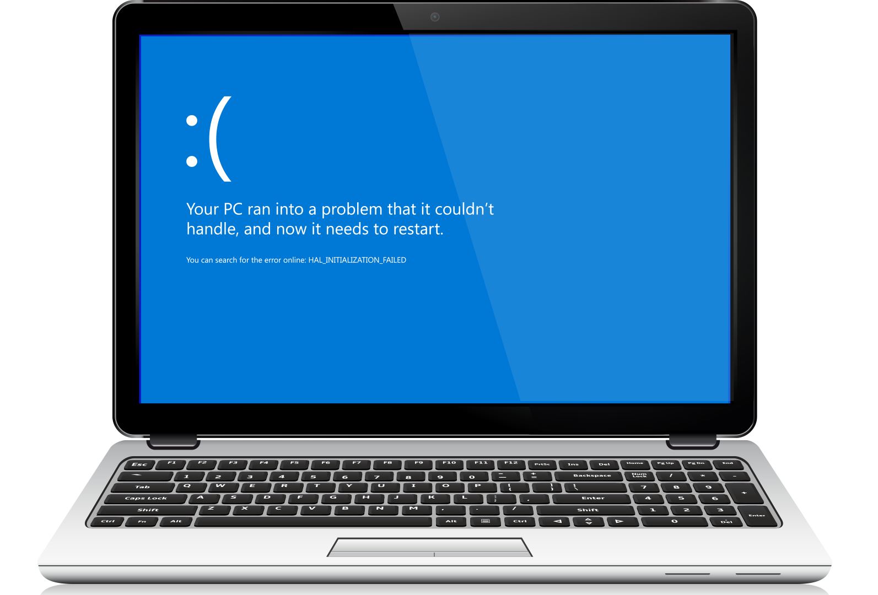
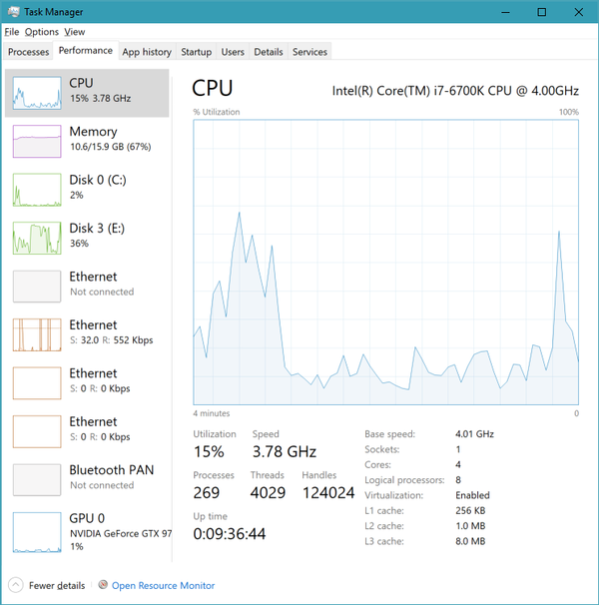
Task Manager
Windows tool that allows:
Auditing and managing processes to identify errant or malicious actions
Inspection of PIDs and startup processes

Slide 16
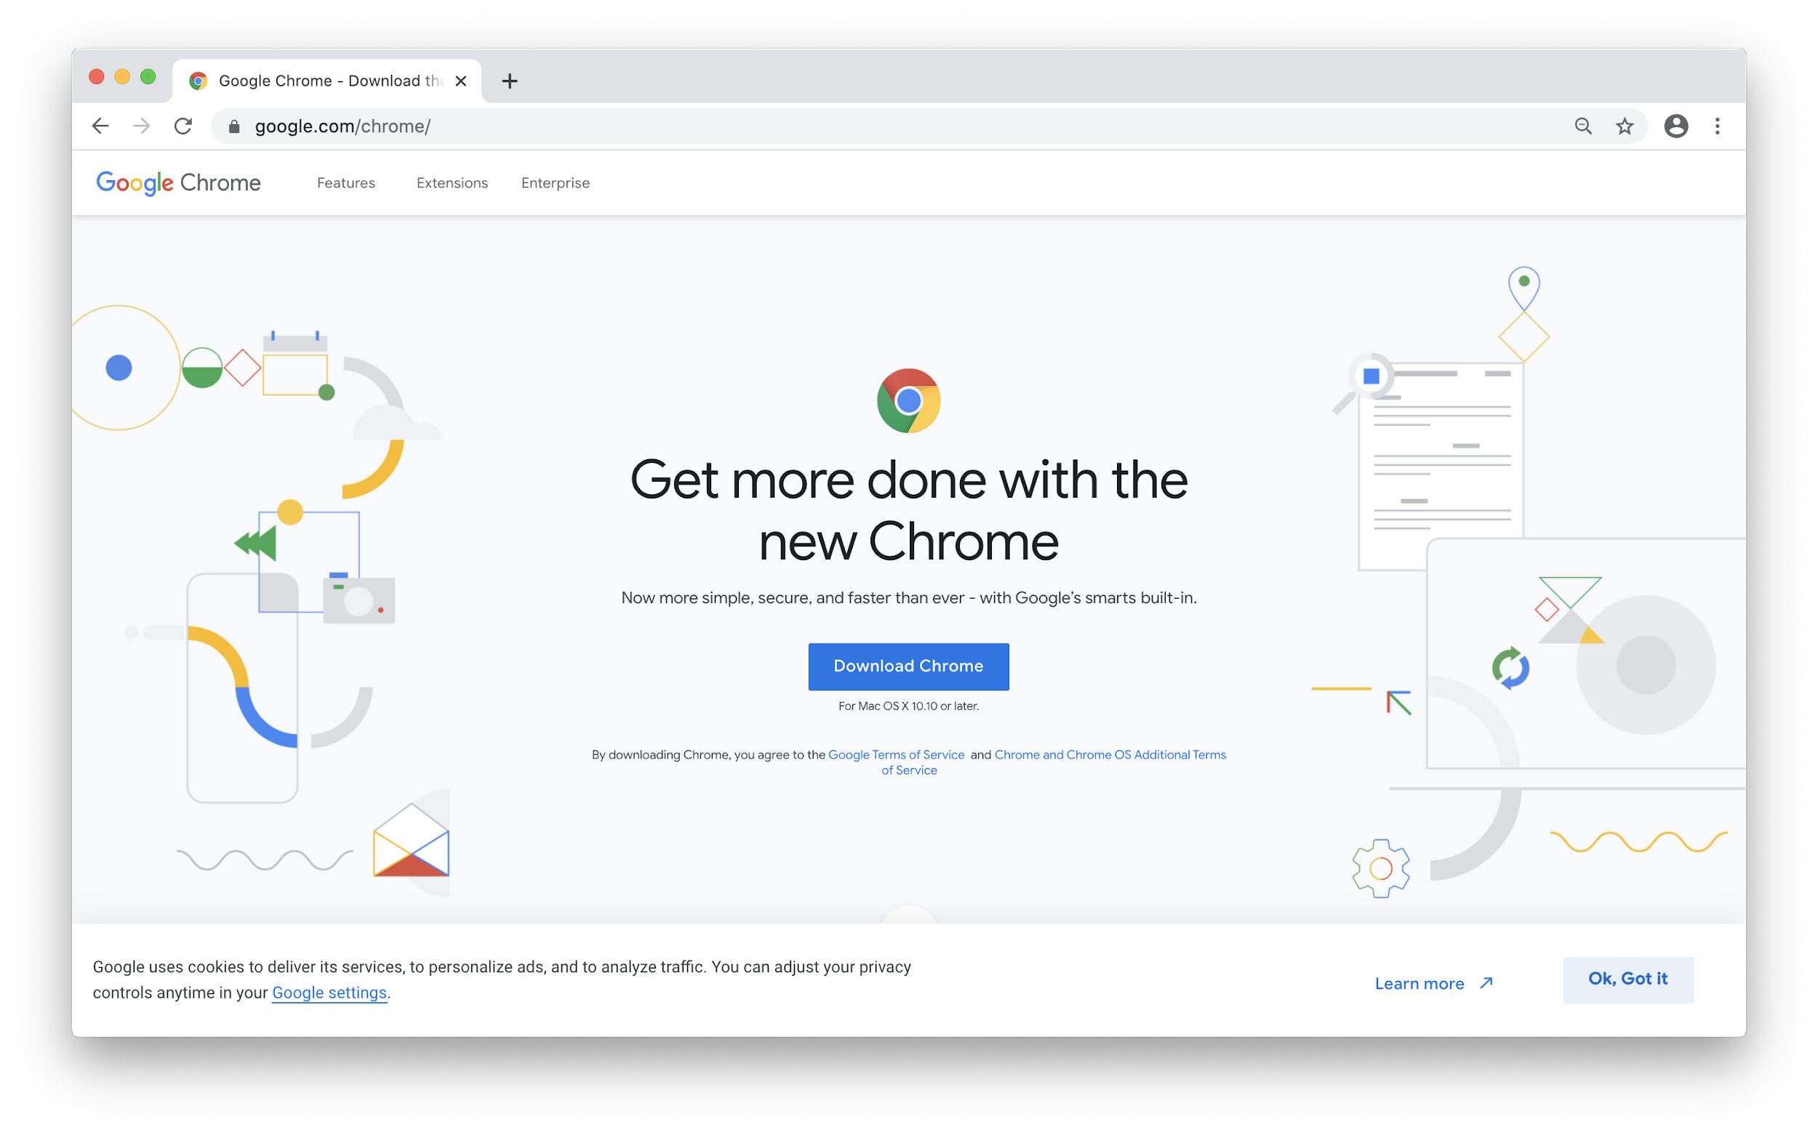
Task Manager
Practical uses for processes
Google Chrome, which is well-known for high memory usage
RDP applications leaving systems vulnerable

Slide 17
Task Manager
Blue Screen of Death
Some processes can cause:
Memory leaks
System instability
System crashes
Blue Screen of Death

Slide 18
Task Manager Overview

Slide 19
Managing Startup Applications
Slow boot times
Excessive resource usage
Network bandwidth allocation
Applications may require special permissions

Slide 20

Windows File Structure

Slide 21
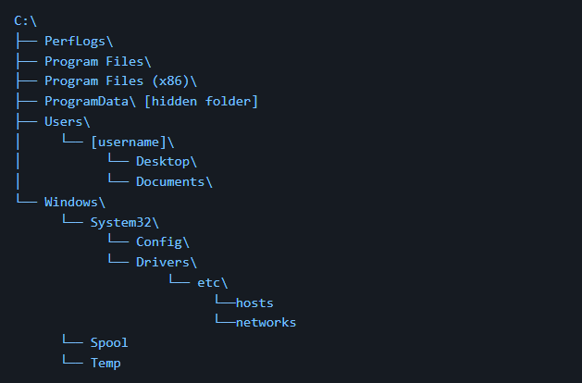
Windows File Structure
Similar to Linux, Windows uses a folder system on a drive with subdirectories
Storage devices are represented by drive letters.
Primary Drive often holds the OS, typically C:\.

Slide 22
Windows File Structure
Directories and Special Folders
Primary Drive
C:\
\ “root” drive
Special folders
Specific purpose folders
Documents, Pictures, etc.

Slide 23


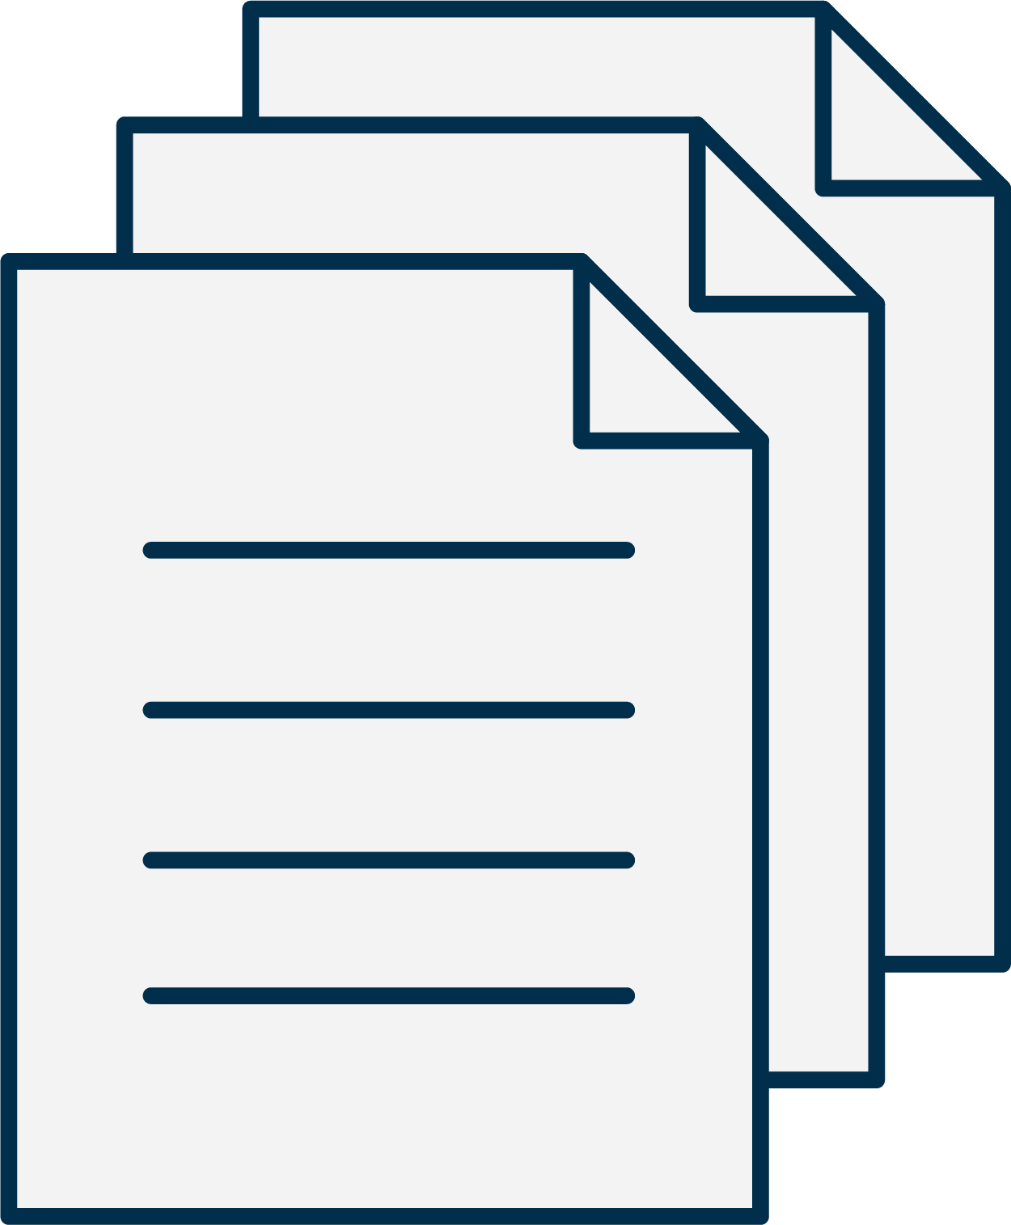



Windows File Structure
Attributes, Extensions, and NTFS
File Attributes
File Extensions
File System
-Read-only
-Hidden
-System
-Applications
Identify the type of files and associate the applications
New Technology File System (NTFS)

Slide 24

Windows OS Folders

Slide 25
Before we did into the OS folders, we need to know the differences in processor architecture.

Slide 26
32-bit vs 64-bit Processors
32
64
32-Bit (x86) Processors
Memory up to 4GB
64-bit Applications won’t work
System cache 1GB
x86
64-Bit (x64) Processors
Memory up to 16TB
Runs 64-bit and 32-bit applications
System cache 1TB
x64

Slide 27
32-bit Operating Systems
32
System Folder
C:\Windows\System32
Contains 32-bit system binaries
Program Folder
C:\Program Files
Contains 32-bit programs

Slide 28
64-bit Operating Systems
64
System Folder
C:\Windows\System32
Contains 64-bit system binaries
C:\Windows\SysWOW64
Contains 32-bit system binaries
Program Folder
C:\Program Files
Contains 64-bit programs
C:\Program Files (x86)
Contains 32-bit programs

Slide 29

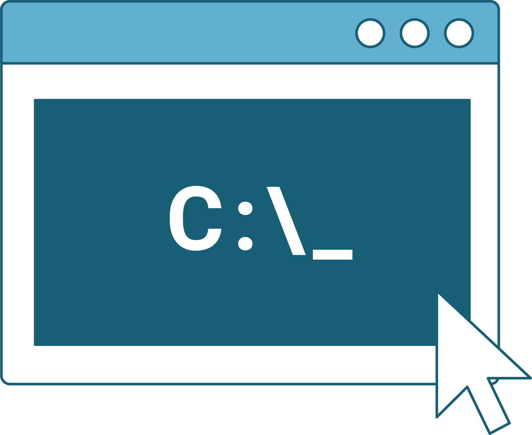
System32 Folder
System32 is a critical Windows directory
System Files
Dynamic link libraries (DLLs)
Executables (EXE)
Device drivers
System Utilities
cmd.exe
taskmgr.exe
regedit.exe
64-bit System Files
64-bit location
SysWOW64 stores 32-bit

Slide 30


Program Files Folder
C:\Program Files and C:\Program Files (x86)
Application Installations
Default directory
Program Data
Data files
Configuration files
Documentation
User Account Control (UAC)
Protects modification or deletion

Slide 31
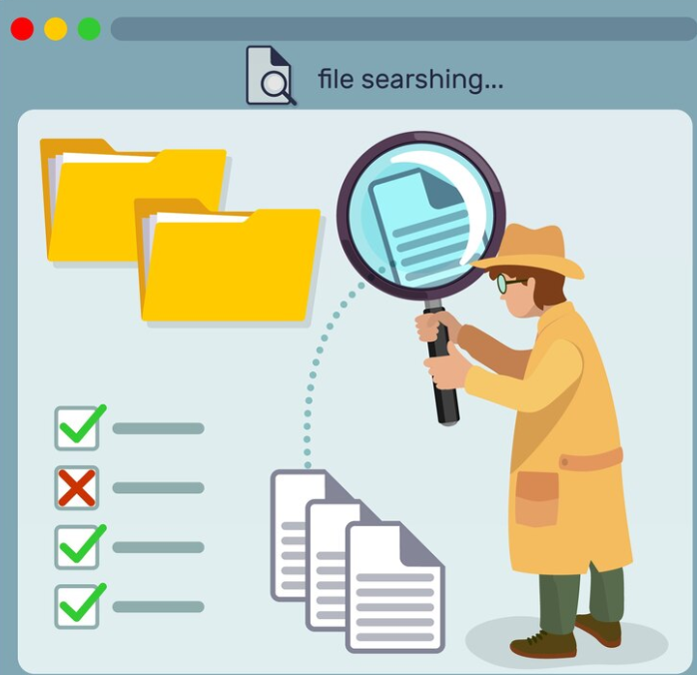
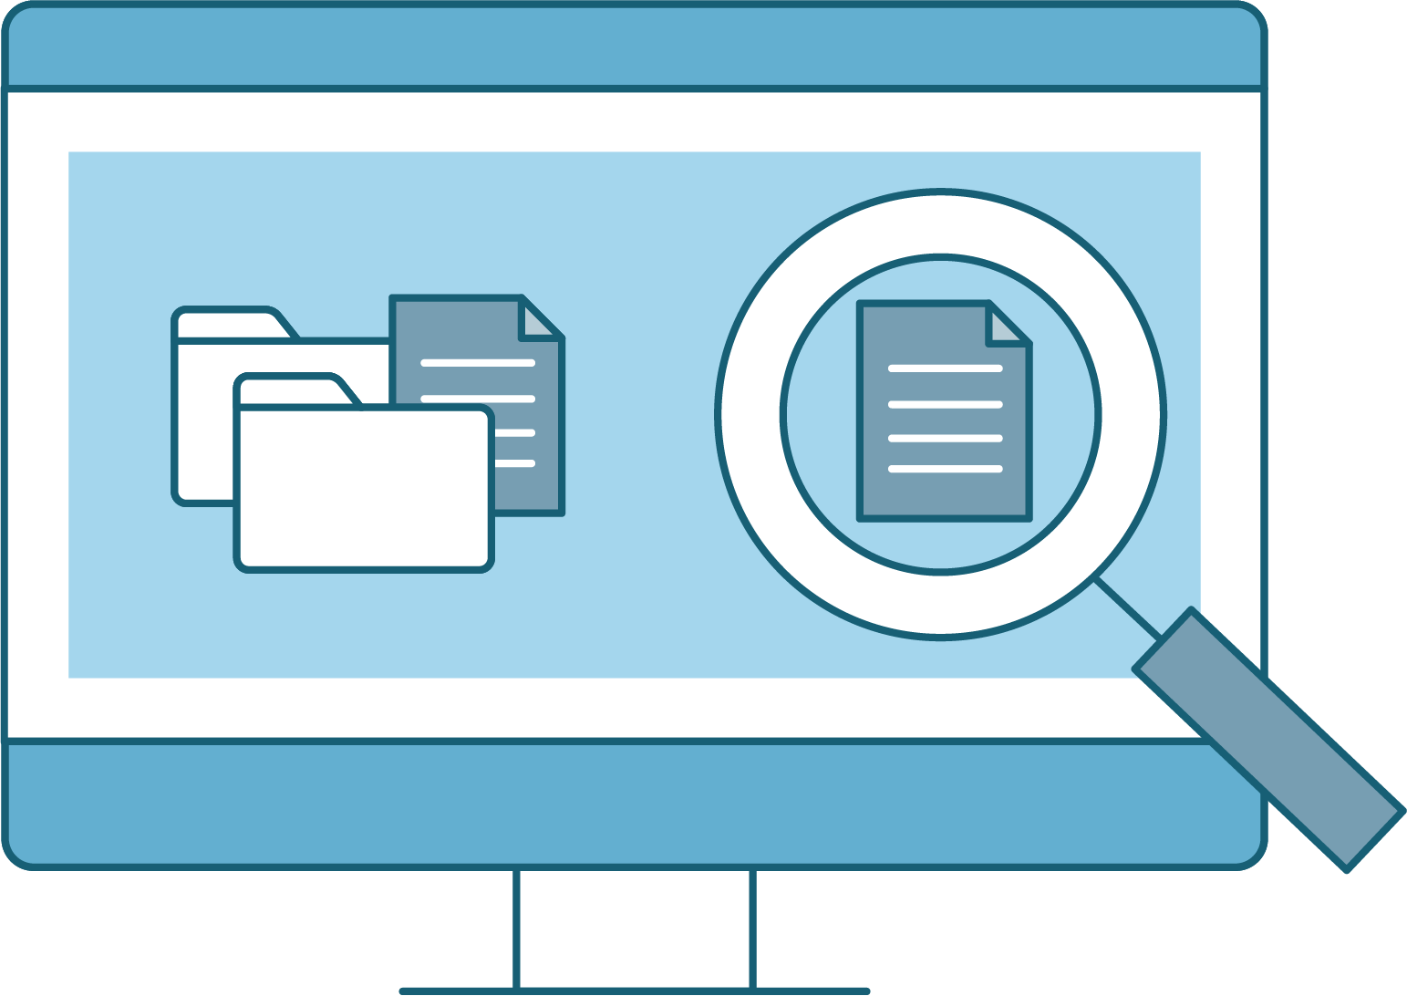
Hidden Folders
Folder and directories in disguise
Visibility
Accidental deletion or modification
AppData, ProgramData
Configuration Files
Application settings
Temporary files
Viewing Hidden Folders
Not visible by default
“Show hidden files, folders, and drives”

Slide 32

Windows Users

Slide 33
Linux uses different account types within the OS. Windows also allows for different accounts and assigns various privileges to them.

Slide 34
A Security Identifier (SID) is a unique alphanumeric string assigned to each security principal (user, group, or computer) in Windows.

Slide 35

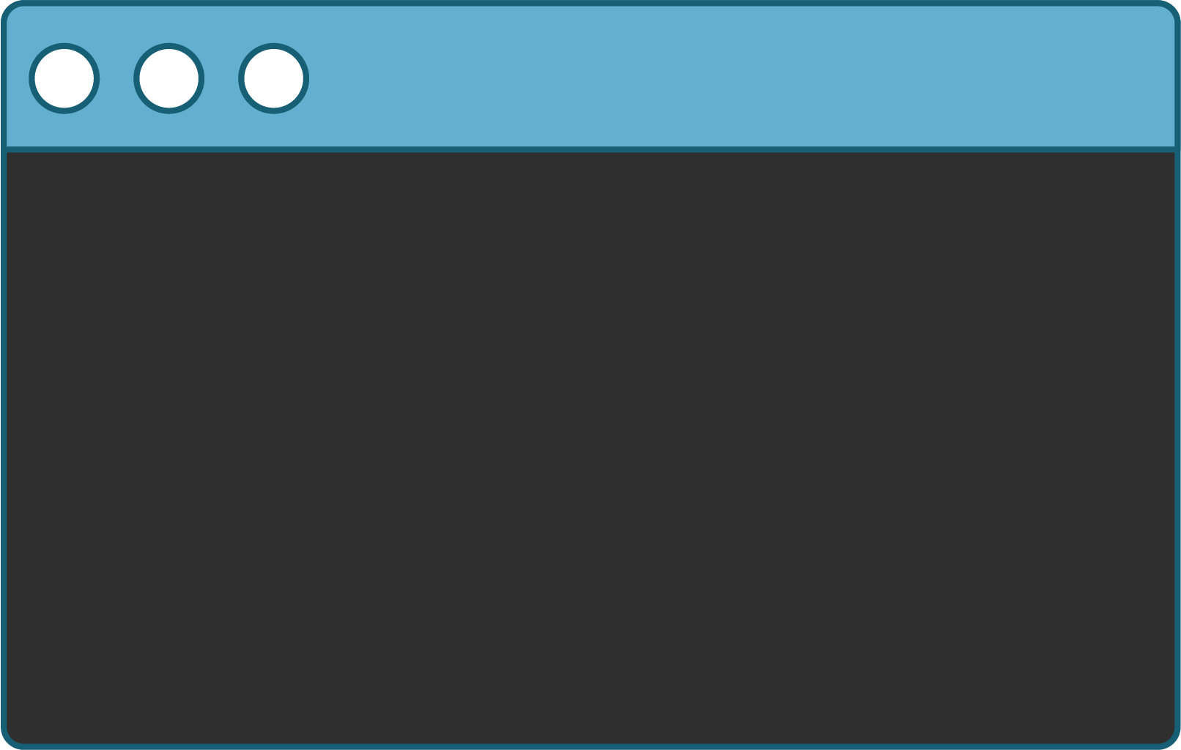
Windows Users
Security Identifier (SID)
Revision Number:
Revision level of SID, typically “S-1”
Identifier:
Authority issued to SID, in Windows always “5”
Sub-Authorities:
Variable number identifies SID within a domain or local system
Identifier
S-1-5-21-3623811015-3361044348-30300820-1013
Revision Number
Sub-Authorities

Slide 36
Windows Users
Additional SID properties in networked environments:
Used extensively in access control lists (ACLs) to define permissions
Identify domain user accounts
SIDs determine user authorization level and access rights
Identify members of security groups

Slide 37
Windows Users
Well-known SIDS
01
Everyone: S-1-1-0 represents all users and groups, including anonymous users.
02
Authenticated Users: S-1-5-11 represents all users who have authenticated to the local or a trusted domain.
03
Local System: S-1-5-18 represents the built-in SYSTEM account with full system privileges.
04
Administrators: S-1-5-32-544 represents the built-in Administrators group.

Slide 38

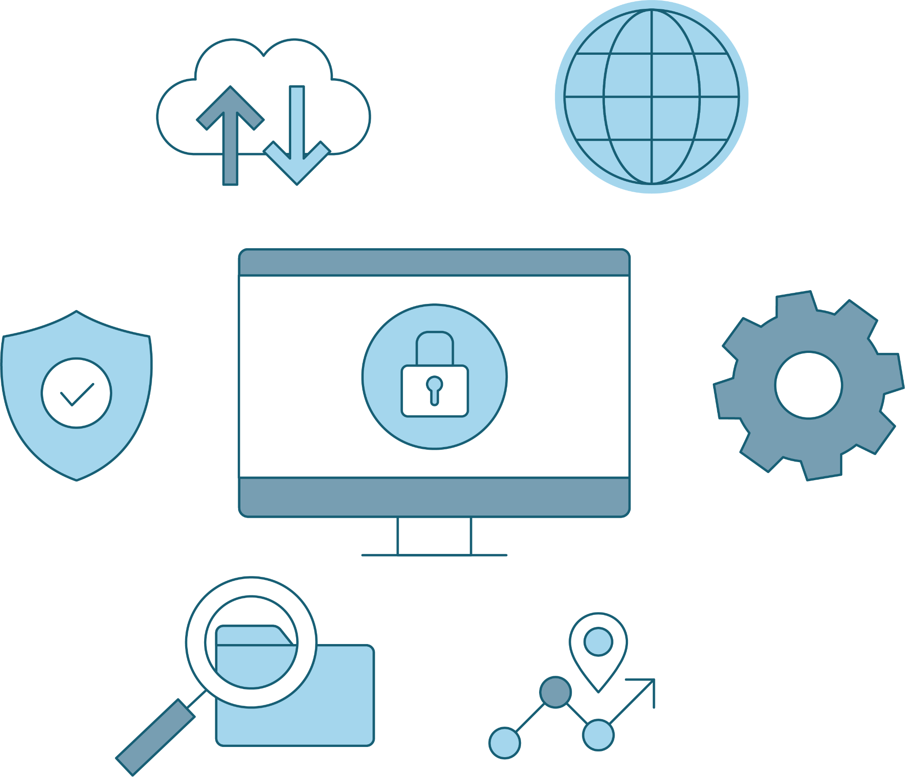
Windows Users
SYSTEM
Similar to Linux’s root, Windows uses the SYSTEM account.
Used by OS itself
Highest level of privileges
Essential for core services and processes
Runs critical services, drivers, and processes for:
  Managing hardware
  Kernel interactions
  Executing operations

Slide 39
Introduction to Command Prompt

Slide 40
The Windows Command Prompt, also referred to as CMD or cmd.exe, is the command-line interface for Windows.

Slide 41
Remember environment variables from the Bash programming unit?

Slide 42
CMD and Environment Variables
In Windows, they work the same way—they’re preset by the system and usable in the command line and scripts.
#!/bin/bash
# set the STRING VARIABLE
STRING="Hello World!"
# print the content of the variable on screen
Echo $STRING_

Slide 43
Environment variables (envvars)
are special values that contain information about the system,
such as the user’s home directory or the system's program files directory.

Slide 44
Common ENV Variables
Envvars can be used for the following:
Shortening long directory paths
Grabbing the current time
Finding the location of system files
Environment Variables | Default Value
%CD% | Current directory
%DATE% | Current date
%OS% | Windows
%ProgramFiles% | C:\Program Files
%ProgramFiles(x86)% | C:\Program Files (x86)
%TIME% | Current time
%USERPROFILE% | C:\Users\{username}
%SYSTEMDRIVE% | C:\
%SYSTEMROOT% | C:\Windows

Slide 45
Common ENV Variables
Linux variables are designated with a $, while Windows ENV variables
are enclosed with % signs.
For example, to navigate to the 64-bit Program Files folder, we run:
cd %ProgramFiles%
We can combine ENV variables with regular directory names:
cd %USERPROFILE%\Desktop
This would send us to the desktop of the current user.

Slide 46
Common ENV Variables
We can combine environment variables with regular directory names:
cd %USERPROFILE%\Desktop
%USERPROFILE% is a variable assigned to the value of the current user’s home directory.
This is the same as $HOME in Linux.

Slide 47

Command Prompt (CMD)
Windows Command Prompt (CMD or cmd.exe), is the command-line interface for Windows, comparable to a Unix shell, such as Bash for Linux.
CMD Command | Action | Linux Counterpart
cd or chdir | Change directory | cd
dir | List contents of directory | ls
md or mkdir | Create directory
copy | Copy file | cp
move | Move (cut and paste) files | mv
del or erase | Delete files and directories
rd or rmdir | Remove a directory if empty
find | Search a file for specified string
exit | Close CMD
type | Show contents of specified file | cat
NOTE
Command prompts are not case-sensitive with files and directories.
cd “Program files” is the same as cd “PROGRAM FILES”.
Use quotes around
the name of a file
or directory that contains spaces.

Slide 48
CMD Parameters and To-Do List

Slide 49
Intro to Task Manager and CMD
In this activity, you will play the role of a junior systems administrator at Good Corp, Inc.
Your CIO has requested that you start a baseline report about a Windows machine. In an upcoming lesson, this Windows workstation will be joined to an Active Directory Domain Controller.
Your CIO has requested that you do the following on the Windows workstation:
  Use Task Manager to clean up running and startup processes.
  Use CMD to create a simple text file in the current user's Desktop directory called report.txt. You will later append Windows system information to it.
15 minutes

Slide 53

Users, Groups, and Password Policies

Slide 54
Next, we’ll use the command-line tool net
to manage user accounts, groups, and password policies.

Slide 55
Using net
We’ll be using the following net utilities:
net user
net localgroup
net accounts
For adding, removing, and managing users.
For adding, removing, and managing local groups.
For viewing password and logon requirements for users to enforce password security policies.

Slide 56
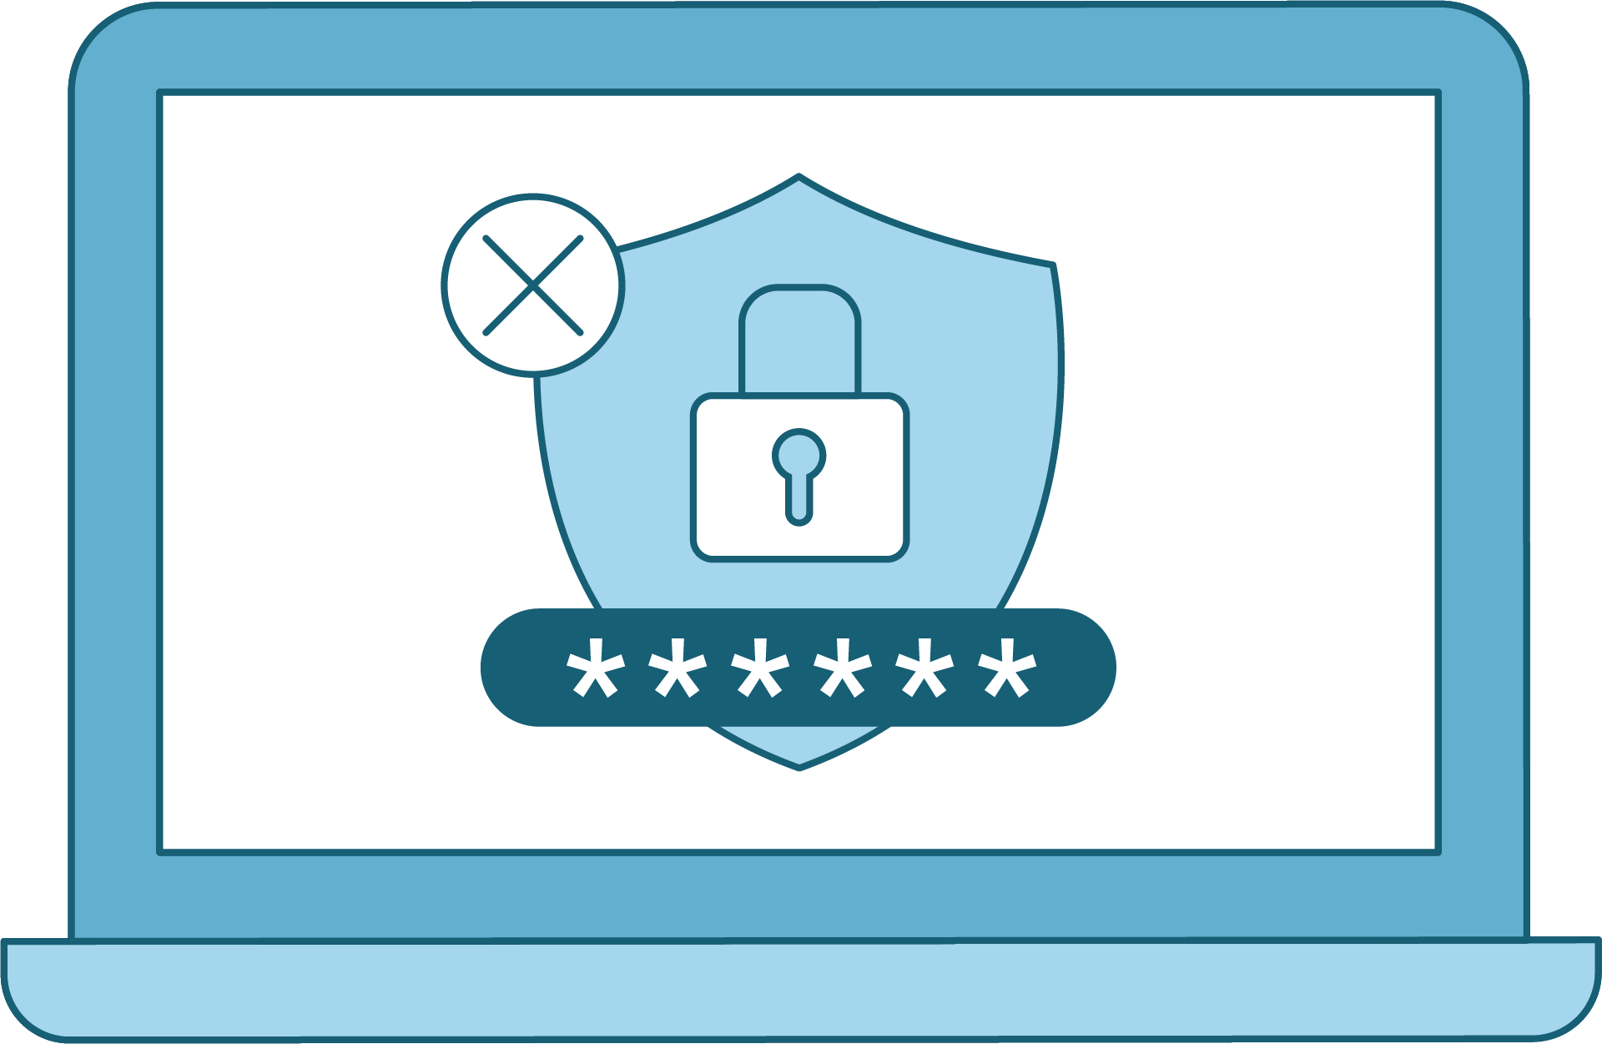

Using net
net can be used to set password policies
The minimum number of characters required for a password
The amount of time before passwords expire
The minimum number of days before a password can be changed
The number of times a password must be unique before it can be reused again

Slide 57



Demonstration Scenario
Your CIO was curious about the groups and password policies on the Windows workstation. You are to retrieve more information from this Windows workstation using the net command-line utility.
Use net to:
Enumerate users to see net output.
Enumerate azadmins group and password policies.
Enumerate local groups.
Enumerate Windows workstation current password policies.
Notes:
shutterstock_1888488028

Slide 58
net

Slide 59
Users, Groups, and Password Policies
Your CIO is curious about what groups and password policies are on the Windows workstation.
You are tasked with retrieving more information from this Windows workstation using the net command-line utility.
10 minutes

Slide 62
Creating Users and Setting
Password Policies

Slide 63
We’ve discussed the importance of password policies in earlier Linux units.
Now we'll demonstrate applying similar concepts in Windows.

Slide 64

Demonstration Scenario
As we saw at the end of the previous activity, there wasn't a minimum password length set. Every organization should have a minimum password length policy.
We'll use the net user utility to create Windows user accounts for two new users:
  Senior Developer, Andrea
  Sales Representative, Barbara
Andrea
Barbara
Notes:
shutterstock_1888488028

Slide 65
Adding Users and Setting Password Policies

Slide 66
Users, Groups, and Password Policies
In the last activity, your CIO had you use the net command-line tool to find various types of information, such as the local groups on the machine and the existing password policy, with accounts.
Your CIO noticed that the previous password policies were not very strict, and wants to enforce new password policies on this Windows workstation for the next two new users: Senior Developer, Andrew, and Sales Representative, Bob.
10 Minutes

Slide 69
Task Scheduling
(Optional/Time Permitting)

Slide 70
Task Scheduler is a GUI tool that allows system administrators
to automate the execution of scripts and applications on a Windows system.

Slide 71
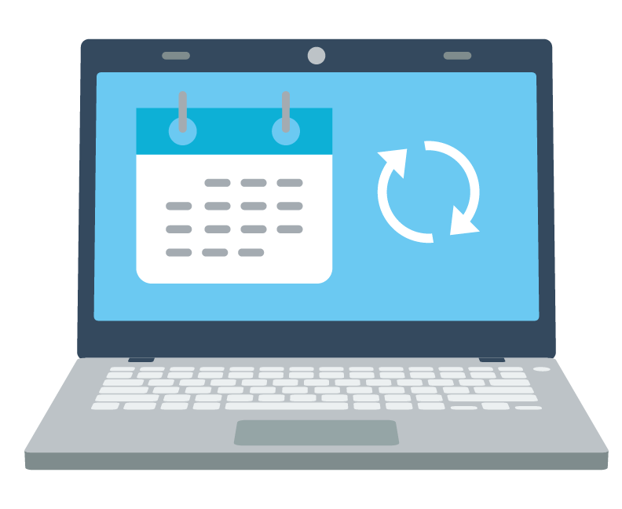
Similar to cronjobs, tasks can be set to execute at specific times, or a certain amount of time after a user logs in.

Slide 72





Task Scheduling
Automating security and system administration
Checking for updates for endpoint security software
Sending important logs
to systems such as SIEM
Scheduling system maintenance scripts

Slide 73

Demonstration Scenario
Your CIO wants to schedule reports to be created on a daily basis. This system isn't remotely managed at the moment, and with a new developer coming in, huge changes might be made to the machine's configuration.
This will help reduce workstation development drift for any new users for the Windows environment, and for this specific developer position and project.
Your CIO has asked you to use the GUI tool Task Scheduler to create a task that will run each day.
Notes:
shutterstock_1888488028

Slide 74
Task Scheduling

Slide 77
PowerShell Scripting

